Slide 1



How do Programmers Maintain Concurrent Code
APSEC 2017
Feiyue Yu, Hao Zhong, Beijun Shen
Shanghai Jiao Tong University

Slide 2

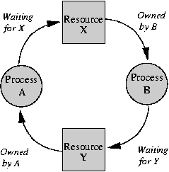
Background
Software maintenance
Expensive, almost 80% of whole budget
Abundant revision histories, useful information
Concurrent programming
Pervasive, employed by more than 75% of projects of a recent study
Difficult, Error-prone, e.g. race, deadlock, etc.

Slide 3
Background
A recent study investigated how programmers maintain concurrent code. They sampled only 25 commits.
Another study explored transformation patterns during software maintenance. They do not touch concurrent code.

Slide 4
Example
Hadoop - commit 4a1acf
- PortmapMapping value = null;
- synchronized(this) {
- map.put(key, mapping);
- value = map.get(key);
- }
- return PortmapResponse.intReply(out, xid, value.getPort());
+ map.put(key, mapping);
+ return PortmapResponse.intReply(out, xid, mapping.getPort());

Slide 5
Benefit
The results can deepen the knowledge on how to maintain concurrent code
Threading / initialization issues. Not all were valid. Make them volatile anyway so FindBugs doesn’t complain. (A commit message of Tomcat)
The results can be useful to improve existing tools
Can we apply our extract change patterns to update concurrent code automatically?
History
Extract
Patterns
Apply
Repo
Search
Code
Code’

Slide 6
Challenge
It is tedious to manually collect many concurrency-related code changes for analysis
We develop tools to help collect and analysis data
The changes on concurrent code can be complicated
Concurrent programming is complex
Commits are incomplete code

Slide 7
Research Questions
RQ1. What change patterns are followed when programmers maintain concurrent code?
Abstract description of similar code changes that appear many times in code revision history
RQ2. How useful are our extracted change patterns, when programmers maintain concurrent code?
Search matching code, apply change patterns

Slide 8
Data Set
Java open-source projects from Apache
Project | #Commits | #Concurrency | #Manual
Hadoop | 14,930 | 2,739 | 64
Tomcat | 17,731 | 1,963 | 207
Cassandra | 21,982 | 1,904 | 78
Lucene-solr | 26,152 | 2,375 | 99
Netty | 7,759 | 1,387 | 210
Flink | 9,771 | 1,500 | 38
Total | 98,325 | 11,868 | 696

Slide 9
Method
Step 1. Collecting commits
Git show command
Step 2. Identifying commits for the follow-up analysis
Textual matching & machine learning
Step 3. Analyzing commits according to different research questions
RQ1. Manual inspection
RQ2. Make pull requests

Slide 10
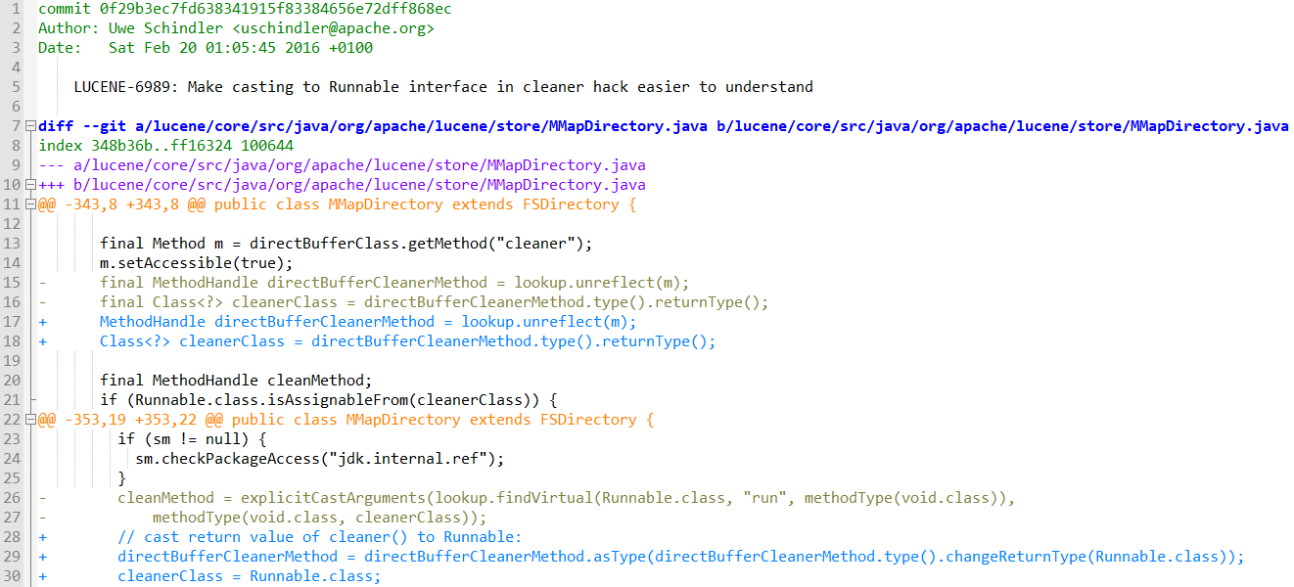
Collecting Commits

Slide 11
Identifying Commits - Textual Matching
Concurrency-related commit → a commit that involves synchronization, thread, or concurrent API classes
96 keywords such as synchronized, volatile, and concurrent API class names
Select 11,868 commits that are concurrency-related commits. Too many for manual analysis
Select 561 commits for manual analysis from the 11,868 commits by checking whether a commit message contains concurrency-related keywords.

Slide 12
Identifying Commits - Machine Learning
SVM
LIBSVM
12 features
Feature | Explanation
msgKey | Number of keywords in commit message
file | Number of files in a commit
hunk | Number of hunks in a commit
lineAdd | Number of added lines in a commit
lineRemove | Number of removed lines in a commit
lineSub | lineAdd - lineRemove
lineSum | lineAdd + lineRemove
keyAdd | Number of added keywords in a commit
… | …
contextKey | Number of keywords in context code

Slide 13
Identifying Commits - Machine Learning
We randomly select 48 commits as a training set
15 positive instances and 35 negative instances
The trained model selects 135 positive commits
Precision = 0.74
Manual inspection
Recall = ?
Universe is too large

Slide 14
Results - RQ1. What Change Patterns
Changing lock types
Changing locked variables
Modifications inside critical section bodies
Changing the volatile keyword
Replacing self-written code with Parallel APIs

Slide 15
Changing Lock Types
YARN
LeafQueue leafQueue = ...; -synchronized (leafQueue) { 57 LOC }
Some details are omitted
LeafQueue leafQueue = ...; +try { leafQueue.getReadLock().lock(); 57 LOC +} finally { + leafQueue.getReadLock().unlock();}

Slide 16
Changing Locked Variables
static final Object lock = new Object(); Map<...> count = new HashMap<>(); -synchronized (count) { - Pair<Job, String> key = - new ImmutablePair<>(jobID, name); - if (count.containsKey(key)) { - count.put(key, count.get(key) + 1); - } else {count.put(key, 1);}}
FLINK
static final Object lock = new Object(); Map<...> count = new HashMap<>(); +synchronized(lock) + if (!jobCounts.containsKey(jobID)) { + jobCounts.put(jobID, new HashMap<>());} + Map<...> count = jobCounts.get(jobID); + if (count.containsKey(name)) { + count.put(name, count.get(name) + 1); + } else {count.put(name, 1);}}

Slide 17
Modifications inside Critical Section Bodies
FLINK
synchronized (buffers) {
if (...) { - if (spillWriter != null) { - spillWriter.close();} isFinished = true;
}
}
synchronized (buffers) {
if (...) isFinished = true;
} +if (spillWriter != null) { + spillWriter.close();
+}

Slide 18
Changing the volatile Keyword
-Membership membership = null; public boolean hasMembers() { if (membership == null) setupMembership(); return membership.hasMembers();} synchronized void setupMembership() { if ( membership == null ) { membership = new Membership(...);}}
Tomcat
+volatile Membership membership = null; public boolean hasMembers() { if (membership == null) setupMembership(); return membership.hasMembers();} synchronized void setupMembership() { if ( membership == null ) { membership = new Membership(...);}}

Slide 19
Replacing Self-written Code with Parallel APIs
HDFS
-private volatile long genstamp; -public synchronized long nextStamp() { - this.genstamp++; - return this.genstamp;
}
+private AtomicLong genstamp; +public long nextStamp() { + return genstamp.incrementAndGet();
}

Slide 20
Results - RQ2. How Useful
We write 3 patches for current versions of open-source projects using our change patterns
We make 3 pull requests and 2 of them are accepted (project names: Schmince-2, Spider4java)
Our change patterns are repetitive in future maintenance, and programmers confirmed that our change patterns are useful
It needs much experience and understanding to leverage our change patterns

Slide 21
Threats to Validity
Threats to internal validity
Our tool can omit some concurrency commits
Threats to external validity
The number of the projects we select is small
They are all Java projects

Slide 22
Future Work
Learn change patterns
Search appropriate contexts
Apply change patterns
Automatically
History
Extract
Patterns
Apply
Repo
Search
Code
Code’

Slide 23
Conclusion
We conduct an empirical study on 98,325 commits that are collected from six popular open-source projects
We implement a set of tools that collect and identify concurrency-related commits automatically
We manually analyze 696 commits
We summarize five change patterns
We find that maintaining concurrent code is not a one-direction migration
We apply our change patterns in real code

